Slide 1

Python for Data Science
19CSE432: Lecture 2
B. Tech. 2021
Course Leader:
Dr. Yatish Bathla
yatishbathla@outlook.com
Dr. Mohan Kumar
mohan.cs.et@msruas.ac.in

Slide 2
Lecture Objectives
At the end of this lecture, student will be able to understand
Installation steps of Python and Visual Studio IDE
Demonstration of operators and variables
Demonstration of Strings, List and Tuple
Demonstration of Conditional Statements
Materials for Reference

Slide 3
Topics
Installation of Python and Visual Studio IDE
Setup Python on Visual Studio IDE
Demonstration of Python Codes
Materials for Reference

Slide 4
Installation of Python and Visual Studio IDE
Install Python on Windows
https://www.youtube.com/watch?v=UvcQlPZ8ecA&t=520s
Install Python on Mac
https://www.youtube.com/watch?v=TgA4ObrowRg
Install Python on Linux
https://www.youtube.com/watch?v=5jrSYA_Ki00

Slide 5
Installation of Python and Visual Studio IDE
Install visual studio code on Windows
https://www.youtube.com/watch?v=MlIzFUI1QGA
Install visual studio code on Mac
https://www.youtube.com/watch?v=tCfbi5PF1y0
Install visual studio code on Linux
https://www.youtube.com/watch?v=Y1fei1mzP7Q

Slide 6
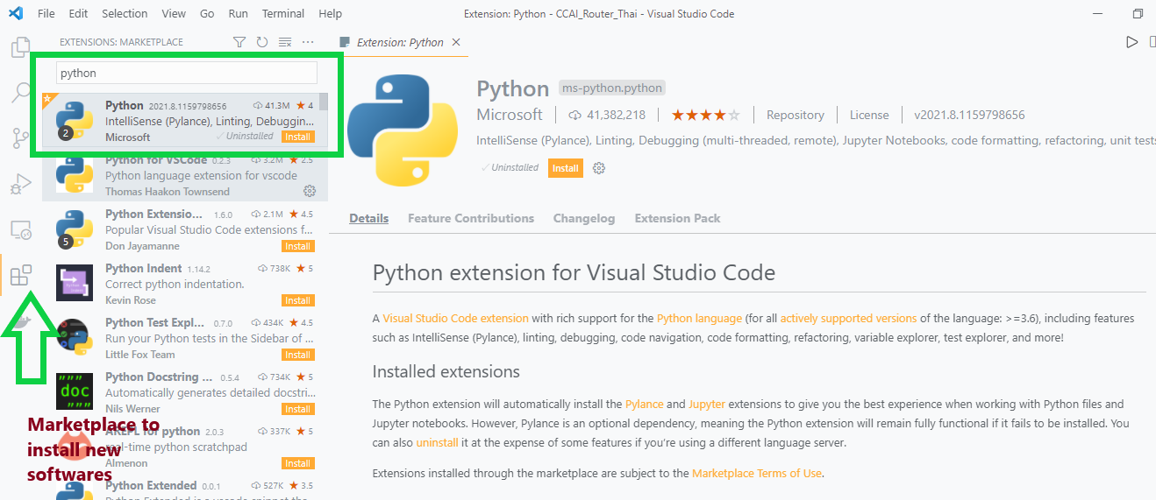
Setup Python on Visual Studio IDE

Slide 7
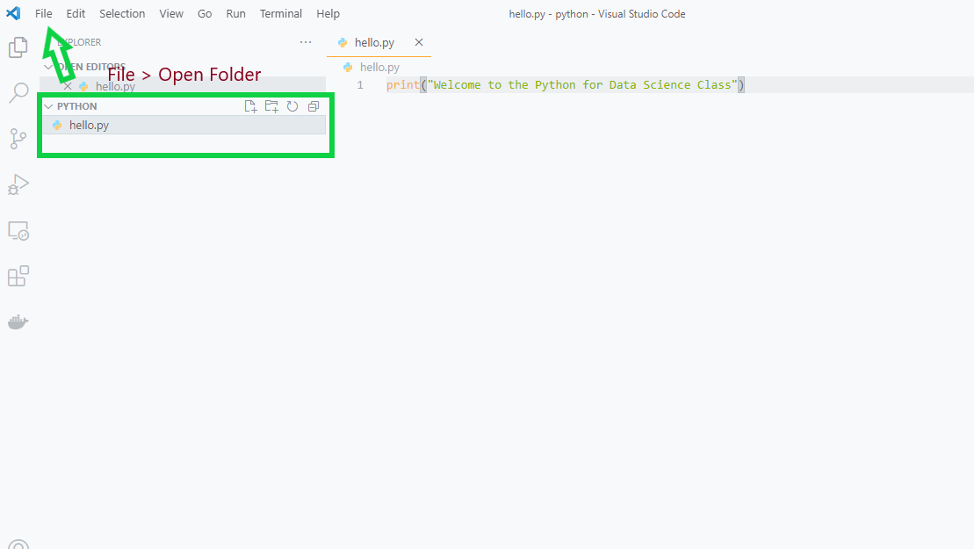
Basic Configuration

Slide 8
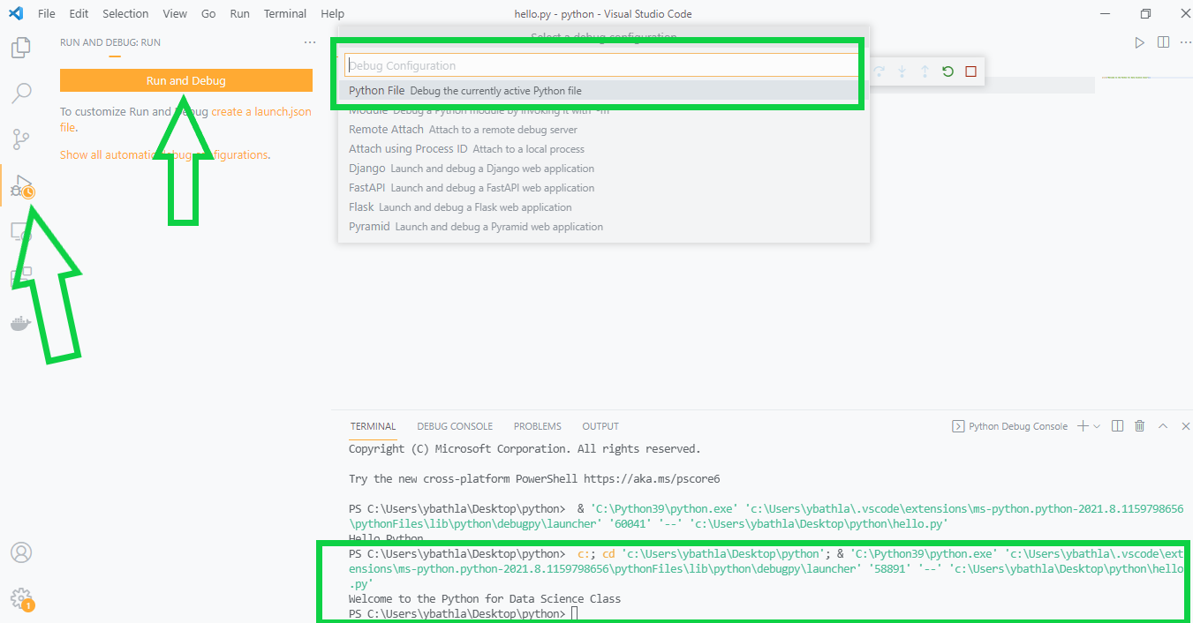
Basic Configuration

Slide 9
Materials for Reference
Recommended/Mandatory
- Core Python Programming, Wesley J. Chun, Publisher: Prentice Hall PTR
- Python for Data Analysis, Wes McKinney, Publisher: O’Reilly
- Parallel Programming with Python, Palash, Jan, 2014, Packt Publishing.
Optional
- Python website: www.python.org
- Data Science Central: www.datasciencecentral.com
- Knowledge Discovery Nuggets: www.kdnuggets.com

Slide 10
Summary
How to install Python and Visual Code Studio in different environment
Demonstration of Python Code using Visual Studio IDE: operators, variables, Strings, List, Tuple, Conditional Statements
Some Useful Shortcuts in Visual Studio: Ctrl + s = save the code, Ctrl + k + c = comment the code, Ctrl + k + u = uncomment the code
Some recommended material for reference

